Slide 1
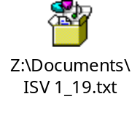
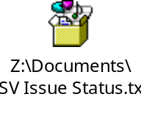
SW Dev Weekly Report
Group | This week (12/11-12/15) | Next
Tele SW Dev | Reinstalled Ubuntu 12.04 runs builds for Gen4 Gerrit.daudio repo sync still unavailable so I have not had the opportunity to build daudio on Ubuntu 12.04 ISV/STMS Issue status training Searched for JF HEV AVN4.0 NA, JFHEV UVO3, JF PHEV AVN4.0 NA_KMA, UM 17MY UVO3, YB/SC UVO3(CANADA), YB/SC(US), YG UVO3 issues. Created builds for D-Audio remotely Ae_phev_quickbppt, daudioplus_sc_ca-eng, and pd.can.000.v068 Flashed builds onto D-Audio H/U Re flashed D-Audio and upgraded to official release | More training ISV/STMS status reporting

